Slide 1
The Death of Distance Revisited: Cyber-place and Proximities – A Test on Quantitative Patterns
Peter Nijkamp
Emmanouil Tranos
Dept. of Spatial Economics
VU University Amsterdam

Slide 2
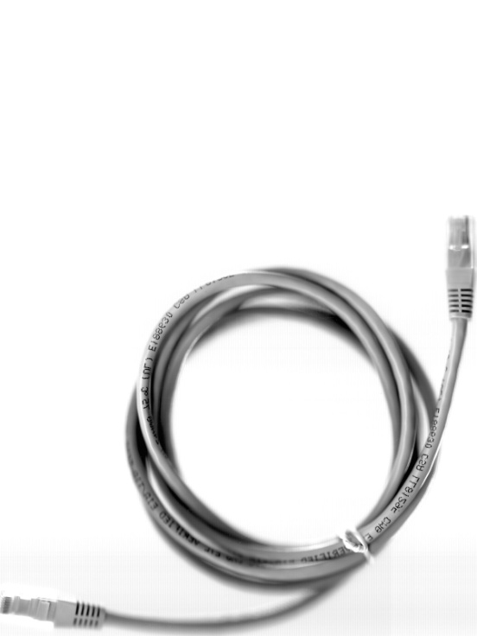
Introduction
Position of the research:
1. Part of our overall research project on “Complexity in Spatial Dynamics”, which aims to:
generate a long overdue typology of urban dynamic processes
represent ways in which actions and interactions measured as flows on networks
explore the properties of these processes and define typical signatures of these dynamics in terms o f scaling, hierarchies, entropy and diversity
measure flows using new sources of data, acquired remotely, some in real- time, from ticketing, mobile and fixed line telephone calls, IP communications, etc.
develop a series of model demonstrators of these urban dynamics

Slide 3
Introduction
2. Continuation of research on the geography of the Internet infrastructure in Europe, which includes:
An analysis of the urban roles and relations due to the Internet backbone networks
An explanatory study of the spatial distribution of the Internet backbone networks
A topological analysis exploring the complex nature of this infrastructure
A study evaluating the causal effects of the Internet infrastructure on the economic development of the European city-regions
A digital accessibility measure for the European cities

Slide 4
Outline
General theoretical framework
The complex nature of digital communication networks
Internet infrastructure and proximities
Concluding remarks future on research

Slide 5
I. General framework
Background
The new spatial form of the space of flows (Castells, 1996).
Virtual geography: cyberplace (CP) vs. cyberspace (Batty, 1997).
Internet geography or cybergeography.
The Internet is not a homogeneous system equally spread around places (Gorman and Malecki, 2000).
The placeless cyberspace depends on real world’s fixities (Kitchin, 1998a and 1998b) found on cyberplace, which is the infrastructural reflection of the cyberspace on the physical space (Batty, 1997).
More than one Internet geography (Zook, 2006).

Slide 6
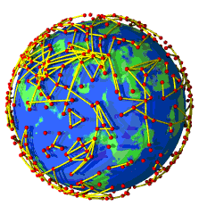
I. General framework
The urban economic geography of the Internet infrastructure
Urban geography: The internet is mostly an urban phenomenon (Rutherford et al., 2004).
Economic geography: ICTs are the backbone of the new – digital – economy (Antonelli, 2003), with processes of production, distribution and exchange increasingly reliant on them.

Slide 7
Studies on the urban economic geography of the Internet infrastructure
Study | Region | Spatial unit | Indicator | Time
Wheeler and O'Kelly 1999 | USA | city, backbone networks | Tc | 1997
Gorman and Malecki 2000 | USA | city | tc, tb, network distance | 1998
Moss and Townsend 2000 | USA | city | Tb | 1997-1999
Malecki and Gorman 2001 | USA | city | tc, tb number of hops | 1998
Townsend 2001a | World | city | Tb | 2000
Townsend 2001b | USA | city | tc, tb, domains | 1997, 1999
Malecki 2002a | Europe | city | tc, tb, colocation points | 2000
 | Europe, Asia, Africa, Americas | continent | peering points | 2000
 | USA | city | tc, tb, b colocation points | 1997-2000
O'Kelly and Grubesic 2002 | USA | backbone networks, city | c, tc | 1997-2000
Gorman and Kulkarni 2004 | USA | city | tb,tc, c | 1997-2000
Malecki 2004 | USA | city | tb, b | 1997-2000
Rutherford et al. 2004 | Europe | city | b, tb, tc | 2001
Schintler et al. 2004 | Europe, USA | city | Tc | 2001, 2003
Rutherford et al. 2005 | Europe | city | c, tc, tb | 2001, 2003
Devriendt et al 2008 | Europe | city | intercity links, IXPs | 2001, 2006
Devriendt et al 2010 | Europe | city | intercity links, IXPs | 2008
Rutherford forthcoming | Europe | city | c, tc, tb | 2001, 2004
Tranos and Gillespie 2008 | Europe | city | tb, tc | 2001
Tranos forthcoming | Europe | city | c, b, tc, tb | 2001-2006
Malecki and Wei 2009 | World | country, city | tc, tb | 1979-2005
b = bandwidth, c = connectivity (i.e. number of connections), t = total; (Tranos and Gillespie 2011)

Slide 8
I. General framework
Global city research: earlier observations
“The global city is not a place but a process. A process by which centres of production and consumption of advanced services, and their ancillary local societies, are connected in a global network, while simultaneously downplaying the linkages with their hinterlands, on the basis of informational flows“ (Castells 1996, 417).
The Internet supports the globalization process, as it is responsible for the transportation of the weightless goods of the global digital economy, but also for the transportation of the ideas which underpin this global process (Taylor, 2004; Graham and Marvin, 2001; Rimmer 1998; Cieslik and Kaniewska, 2004)
ICTs enabled the spatial dispersion of economic activity (long distance management) and reorganisation of the finance industry (instant financial transactions) (Sassen, 1991).

Slide 9
I. General framework
What is the impact of distance and proximity on digital infrastructure?
Is it the end of distance? While we haven’t experienced the death of cities (Gilder, 1995; Drucker 1989 cited in Kolko, 1999), the death of distance (Cairncross, 1997), the emergence of electronic cottages (Toffler, 1981) and in general the end of geography due to ICT, we still do not know how distance affects virtual interaction? Does physical space perform a complementary or a supplementary role in digital communications?
Test whether Tobler‘s (1970, 236) first law of geography is valid in the frame of the digital economy.
“Everything is related to everything else, but near things are more related than distant things”
Expand the notion of distance to include relational distances which cannot be approached in a unidimensional way, just as a Cartesian spatial object (Graham 1998)

Slide 10
I. General framework
How de we approach this cyber question?
Explore the complex nature of digital communication networks
Test empirically test the impact of physical distance and relational proximities on the formation of CP using gravity models

Slide 11
II. The complex nature of digital communication networks
A new analytical departure based on the new science of networks (Barabási, 2002; Buchanan, 2002; Watts 2003, 2004), with a focus on large-scale real world networks and their universal, structural and statistical properties leading to a better understanding of the underlying mechanisms governing the emergence of these properties (Newman, 2003)

Slide 12
II. The complex nature of digital communication networks
Transportation science and spatial economics have traditionally an interest in networks and interregional systems (Cornell University, 2011).
Reggiani (2009) explores in detail the joint between spatial economics and network analysis:

Slide 13
II. The complex nature of digital communication networks
Two main streams of complex network analysis:
A more descriptive one, which focuses on various network measures and compares real networks with theoretical models such as scale-free networks, mostly using the (cumulative) degree distribution (e.g. Gorman and Kulkarni 2004; Schintler et al 2004; Regianni et al 2010; Tranos 2011)
A hard modeling one, which is based on modeling exercises in order to simulate the evolution of empirical networks, based on stochastic approaches and statistical physics (e.g. Barabási and Albert 1999; Albert and Barabási 2002)

Slide 14
II. The complex nature of digital communication networks
Examples of such complex networks include: transport and telecommunication flows and their underpinning infrastructural networks, trade, migration etc.
Spatial Complex Networks: physical, digital, virtual, economic, logical, social and other type of networks. These are “systems composed of a large amount of elementary components [i.e. links and nodes] that mutually interact through non-linear interactions, so that the overall behaviour is not a simple combination of the behaviour of the elementary components” (Crucitti et al 2003).

Slide 15
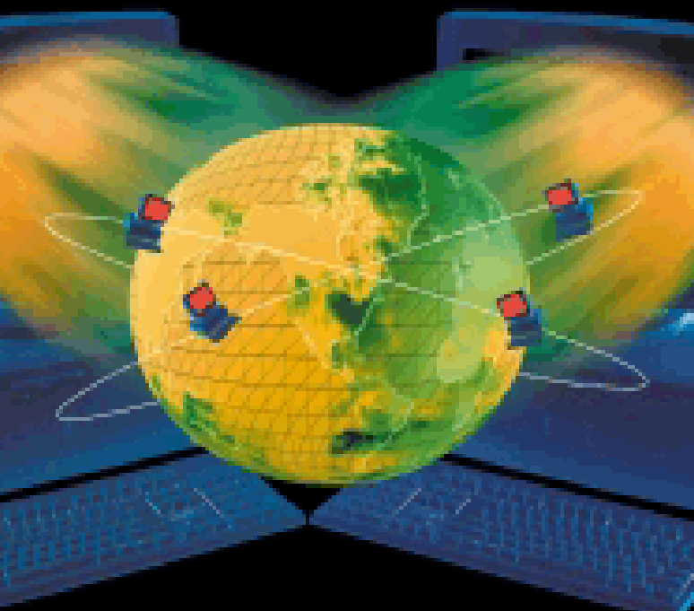
II. The complex nature of digital communication networks
Operational approach:
Structural analysis of an IP network:
Intra-european city-to-city links aggregated at NUTS3 level
Infrastructural network: inter-city digital links operating at the level 3 of the OSI system
Observations over time (2005-2008)
Fraction of the overall Internet: based on traceroutes
data source: DIMES Project 2011

Slide 16
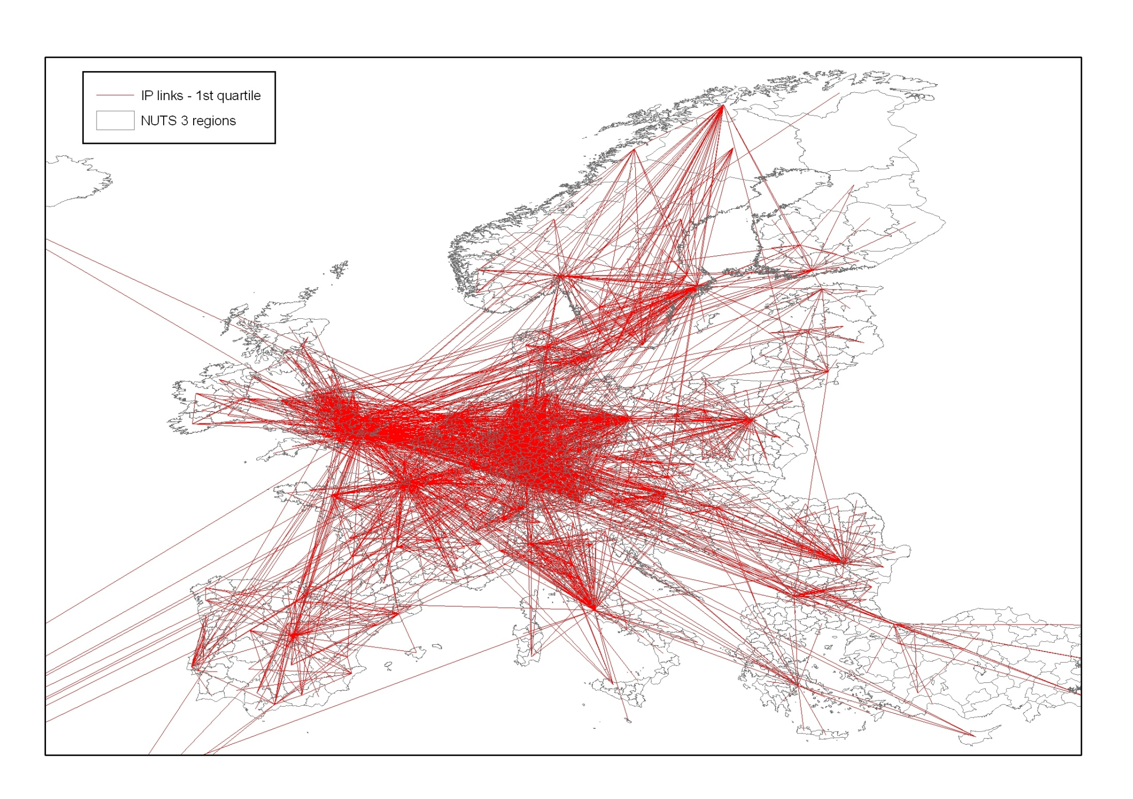
Intra-European IP links, 2007

Slide 17
II. The complex nature of digital communication networks
Network measures
Year | # of European nodes | # of intra-European IP links | av. degreeª | max. degree* | Gini coef. | densityª | av. dist.ª | av. dist. RN | CCª | CC RN
2005 | 1376 | 23352 | 1084 | 44313 | 0.727 | 0.024 | 2.295 | 2.831 | 0.71 | 0.012
2008 | 1276 | 19521 | 1490 | 77692 | 0.741 | 0.023 | 2.176 | 2.891 | 0.69 | 0.012
ª for these metrics, links between Europe and the rest of the world were also included in the analysis.
Increase in the average and maximum degree centrality
Highly uneven degree distribution ➔ hierarchy, hub roles
Low average distances ➔ efficiency
Small world characteristics (CC >> CC RN, av. dist < av. Dist. RN)

Slide 18
II. The complex nature of digital communication networks
Nodes degree distribution
Two different curves for both years:
a straight line indicating a power law for the most-connected nodes of the IP network
a curve suggesting an exponential law for the least-connected nodes

Slide 19
II. The complex nature of digital communication networks
Curve estimations (OLS and log transformations)
Three hypothesis:
exponential
power
power with cutoff (Tanner function)
 |  | Exponential |  | Power |  | Tanner function
 | N | R² | Coef. | R² | Coef. | R² | Power Coef. | Exp. Coef.
2005 | 1376 | 0.679 | 0.0003 | 0.733 | -0.481 | 0.909 | -0.323 | -0.0002
2008 | 1276 | 0.632 | 0.0002 | 0.712 | -0.435 | 0.889 | -0.305 | -0.0001

Slide 20
II. The complex nature of digital communication networks
Curve estimations (OLS and log transformations)
At an aggregated NUTS-3 level, the European IP network fails to form a clear SF structure.
Possible explanation: physical and topological constraints, which are important even for the development of the digital Internet infrastructure
In spatial terms:
agglomeration effect of IP connectivity in a limited number of regions (hubs)
the exponential tail reflects the existence of a cluster of less-connected regions, which is more homogeneous in terms of IP connectivity than if a hierarchical and clear SF topology were present

Slide 21
III. Internet infrastructure and proximities
Empirical testing of the impact of different types of proximities on the formation of CP
Starting point: the first law of geography and the importance of physical distance on CP
Proximity is not limited only on physical distance
French School of Proximity: the spatial dimension of enterprises and organizations
Its main objective: to incorporate space and other territorial proximity elements to better understand the dynamics of innovation (Torre and Gilly 2000)
Evolutionary economic geography: the notion of proximity and its different components are juxtaposed with ideas about knowledge transfer and creation, tacit knowledge, and learning regions (Boschma 2004)

Slide 22
III. Internet infrastructure and proximities
Empirical testing of the impact of different types of proximities on the formation of CP
Common characteristic of the French School of Proximity and Evolutionary Geography: the importance of non-spatial types of proximity in innovation creation
We ‘borrow’ the conceptual work on the different proximity dimensions, and redefine and use them in a new empirical framework in order to understand the impact of different types of proximity in the formation of the CP
Proximity and distance are just other facets of cost which needs to be incorporated in the connectivity decisions taken by Internet Service Providers (ISPs)

Slide 23
III. Internet infrastructure and proximities
Empirical testing of the impact of different types of proximities on the formation of CP
1

Slide 24
III. Internet infrastructure and proximities
Different types of proximities
Proximity type | Variable | Data source | Expected sign
Geographic | Physical distance in km (natural logarithm) | Own calculations | -
Cognitive | Core-to-core (IP) | Own calculations | +
 | Core-to-periphery (IP) | Own calculations | -
Organizational | World cities | GaWC, own calculations | +
Institutional | Intra-country virtual interaction | Own calculations | +
 | Intra-region virtual interaction | Own calculations | +
Population | Absolute population distance (natural logarithm + 1) | Eurostat, own calculations | ?

Slide 25
III. Internet infrastructure and proximities
Empirical testing of the impact of different types of proximities on the formation of CP
Gravity model to test the impact of physical distance and relational proximities on city-to-city IP communications links aggregated at NUTS3 city-region level.
IP_{ij,t}: the intensity of IP links between i and j
IP_{i,t} and IP_{j,t}: mass of i and j (IP connectivity including extra-European links)
b₁₋₆: betas for the different proximity variables
year dummies, country-to-country effects

Slide 26
III. Internet infrastructure and proximities
Empirical testing of the impact of different types of proximities on the formation of CP
Panel data specification: c. 40k city-to-city links for 4 years
Random effects (RE)
In order for the RE estimates to be consistent, there is a need for the unobserved random effects to be uncorrelated with the repressors
The proximity variables might be endogenous by being correlated with omitted – unobservable – variables which affect the formation of IP links between regions
Use of Hausman and Taylor (HT) model (Hausman and Taylor 1981). This model utilizes both the between and within variation of the exogenous variables as instruments ➔ Hausman test (Hausman 1978) in order to test the exogenous nature of the regressors
Correction for potential selection bias

Slide 27
Dep. Var.: Ip_ln | (1) | (2) | (3) | (4) | (5) | (6) | (7)
dist_ln | -0.935 | -0.92 | -0.922 | -0.352 | -0.344 | -0.34 | -0.192
 | (0.008)*** | (0.008)*** | (0.008)*** | (0.009)*** | (0.010)*** | (0.011)*** | (0.010)***
c2p |  | -0.178 | -0.17 | -0.116 | -0.153 | -0.064 | -0.112
 |  | (0.019)*** | (0.019)*** | (0.018)*** | (0.019)*** | (0.018)*** | (0.018)***
c2c |  | 0.555 | 0.538 | 0.36 | 0.368 | 0.387 | 0.243
 |  | (0.030)*** | (0.030)*** | (0.030)*** | (0.030)*** | (0.030)*** | (0.028)***
gawc |  |  | 0.397 | 0.34 | 0.303 | 0.424 | 0.157
 |  |  | (0.047)*** | (0.043)*** | (0.045)*** | (0.044)*** | (0.040)***
cntr |  |  |  | 1.841 | 1.823 | 1.032 | 1.058
 |  |  |  | (0.022)*** | (0.023)*** | (0.259)*** | (0.242)***
inter |  |  |  | 2.733 | 2.967 | 2.358 | 1.537
 |  |  |  | (0.044)*** | (0.053)*** | (0.053)*** | (0.049)***
pop_diff |  |  |  |  | 0.043 | -0.019 | -0.05
 |  |  |  |  | (0.006)*** | (0.006)*** | (0.006)***
ip_o_ln | 0.445 | 0.477 | 0.468 | 0.572 | 0.571 | 0.636 | 0.473
 | (0.005)*** | (0.006)*** | (0.006)*** | (0.005)*** | (0.006)*** | (0.006)*** | (0.006)***
ip_d_ln | 0.392 | 0.421 | 0.415 | 0.569 | 0.568 | 0.635 | 0.473
 | (0.005)*** | (0.005)*** | (0.005)*** | (0.005)*** | (0.006)*** | (0.006)*** | (0.006)***
 |  |  |  |  |  |  | (0.015)***
Constant | 1.477 | 0.894 | 1.007 | -5.543 | -5.76 | -5.813 | -5.272
 | (0.062)*** | (0.070)*** | (0.072)*** | (0.098)*** | (0.102)*** | (0.282)*** | (0.263)***
Time effects | yes | Yes | yes | yes | yes | yes | yes
Country-pair effects | no | no | no | no | no | yes | yes
Hausman test | - | - | - | - | - | 147.24 | -
Observations | 83700 | 83700 | 83700 | 83700 | 77553 | 77553 | 77553
Select.bias var. |  |  |  |  |  |  | yes
Number of link | 44518 | 44518 | 44518 | 44518 | 42396 | 42396 | 42396
Note: Standard errors in parentheses.
* significant at the 10% level; ** significant at the 5% level; *** significant at the 1% level.

Slide 28
III. Internet vs. physical geography: the role of distance
Results
IP connectivity appears to be higher between neighbouring regions in terms of:
physical,
technological,
organizational, and
institutional distance.
➔ Tobler’s first law of geography is valid in CP
➔ Border and localization effects become significant, even for the digital infrastructure
➔ Costs are also observed in terms of linking dissimilar agglomerations

Slide 29
V. Concluding remarks future research
Centripetal forces agglomerate IP links in specific locations, which act as the hubs of this digital infrastructure
Centrifugal forces ‘protect’ the less-connected regions, securing a level of connectivity which would not be observed if clear SF structures were utilized
Core-periphery patterns can be identified at a global level
Border and even local effects have a strong impact on IP connectivity reflecting both cost constraints but also prospects for demand for local communications
Novelty of research: spatial and quantitative perspective on digital world
New research questions emerge for virtual phenomena with
real-world implications

